Slide 1
Azure Monitor Overview
Name

Slide 2
Agenda
13:00-13:10: Kickoff & Introductions
13:10-13:25: Setup Platform
13:25-13:30: Monitoring Platform Overview
13:30-14:10: Config Monitoring Solution
14:10-14:20: Setup Data Platform
14:20-14:50: Break
14:50-15:00: Data Platform Monitoring Overview
15:00-16:30: Config and Monitoring Data Platform
16:30: Drinks (Petition)

Slide 3
Monitoring landscape – apps & infrastructure
Infrastructure
Apps
Network
</>

Slide 4

Azure Monitor
Full observability for your infra, app and network
Metrics
Log
Common Store
Unified Monitoring
Data Driven Insights
Workflow Integrations
A common platform for all metrics, logs and other monitoring telemetry
Advanced diagnostics and analytics powered by machine learning capabilities
Rich ecosystem of popular DevOps, issue management, SIEM, and ITSM tools

Slide 5



Signals and Sources in Azure
Signals
Sources
Application
User telemetry
Application logs
Metrics
Guest OS (‘user space’)
Linux syslog
Windows Perf Counters
Azure Resources
Virtual Machines
Logs
Storage Accounts
Network Security Groups
Azure Subscriptions
Resource Manager
Alerts
Service Health
Security Center
Azure Tenants
Azure Active Directory

Slide 6



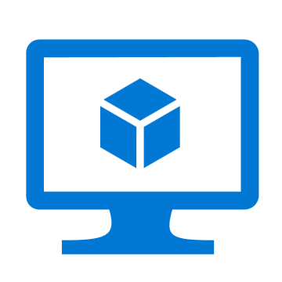
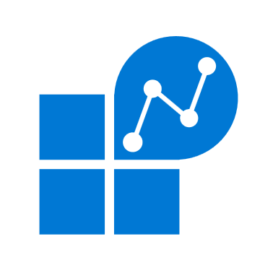
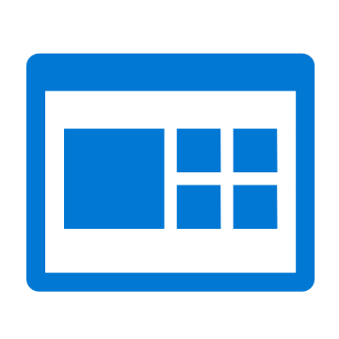





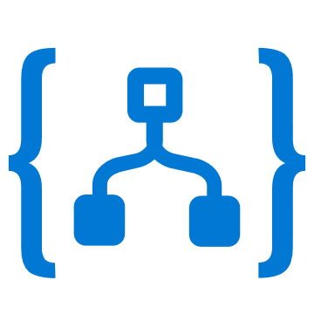
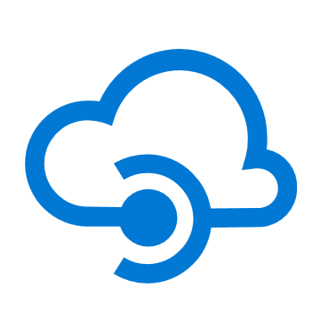
Azure Monitor
Insights
Application
Container
VM
Monitoring Solutions
Application
Operating System
Visualize
Metrics
Dashboards
Views
Power BI
Workbooks
Azure Resources
Azure Subscription
Analyze
Logs
Metrics Explorer
Log Analytics
Azure Tenant
Respond
Custom Sources
Alerts
Autoscale
Integrate
Event Hubs
Logic Apps
Ingest & Export APIs

Slide 7
Wiring it all up
Application
Application Insights
SDK Driven
Multi-Language Support
Azure Monitor
Operating System
Diag. Extensions + Agents
Windows + Linux Support
Workload Agnostic
Metrics
Azure Resources
Azure Subscription
Logs & Metrics emitted by Azure
Logs
Azure Tenant
Custom Sources
For everything else

Slide 8
Unified Monitoring

Slide 9
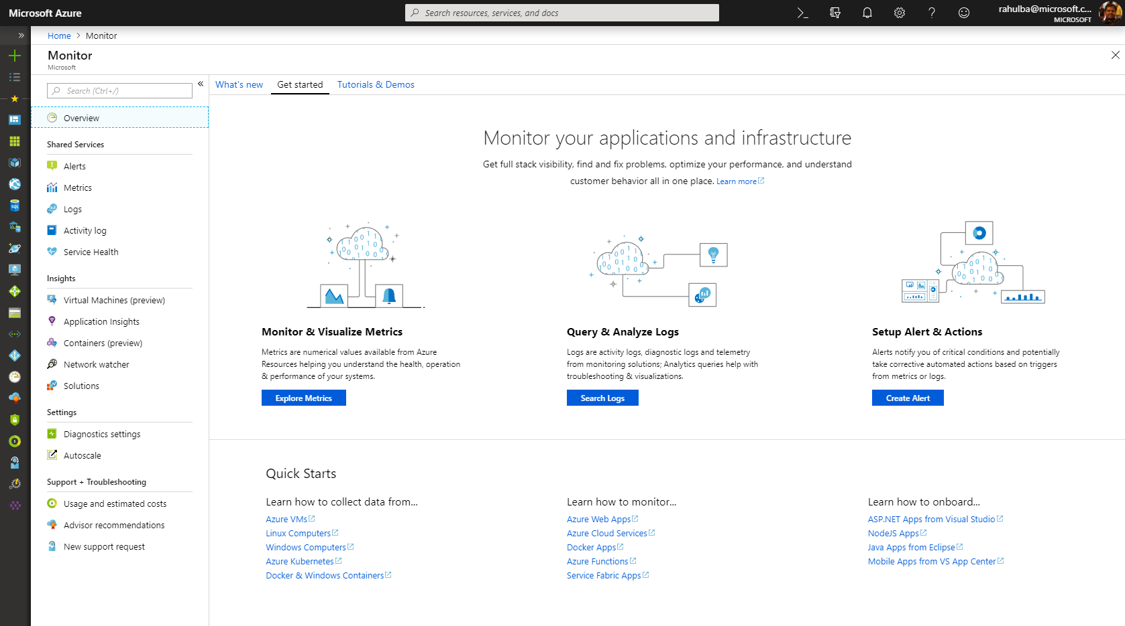
Unified Monitoring
NEW
One Metrics, One Logs, One Alerts across Azure/on-prem resources
Unified offering with App Insights & Log Analytics as integrated features
Integration into native Azure resource blades
Ability to send custom metrics & custom logs

Slide 10
Data Driven Insights

Slide 11
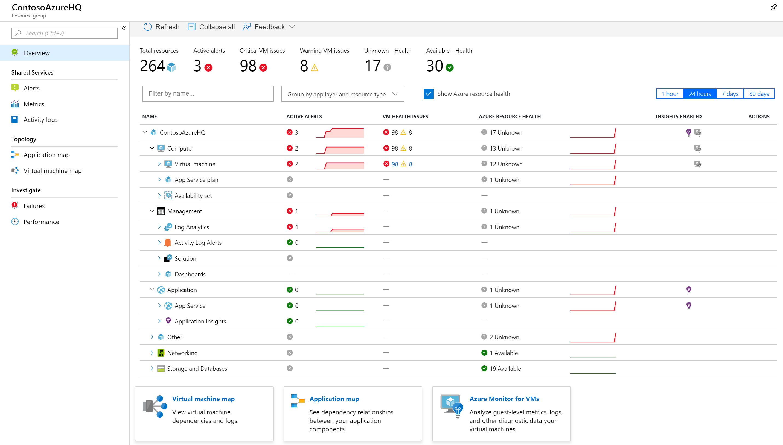
Full Stack Visibility in Resource Groups
NEW
Monitor health state of all resources
See alerts firing across app & infra
Jump to Application Map or VM Map
Drill down into failures or perf issues

Slide 12
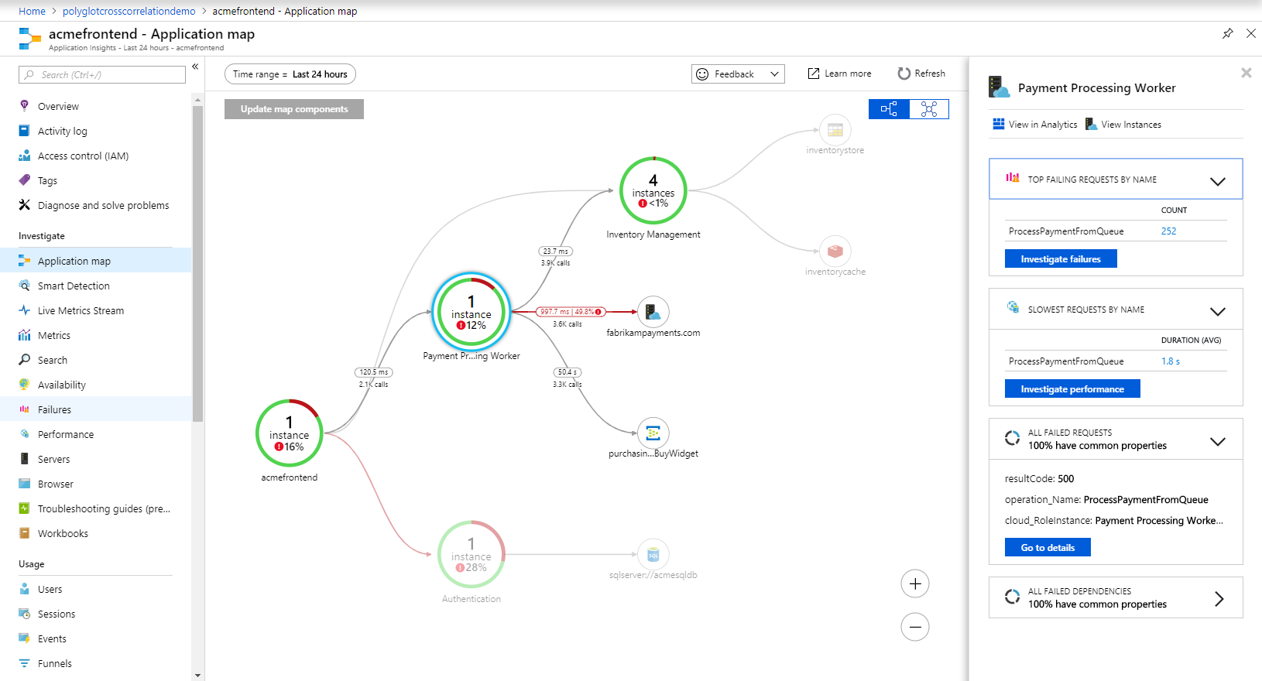
Diagnose E2E issues with Application Insights
Monitor apps in .NET, JS, Java, Node.js or any language with OSS SDKs
Visualize server/client connections & dependencies with App Map
Track E2E distributed transactions (including for Python & Go) NEW!
Drill down to code-level with Snapshot Debugging & Profiling
Understand end-user cohorts, behavior & engagement for planning
Learn more: BRK3346 (Build the right solution for your business by Continuous DevOps Monitoring and Learning)

Slide 13
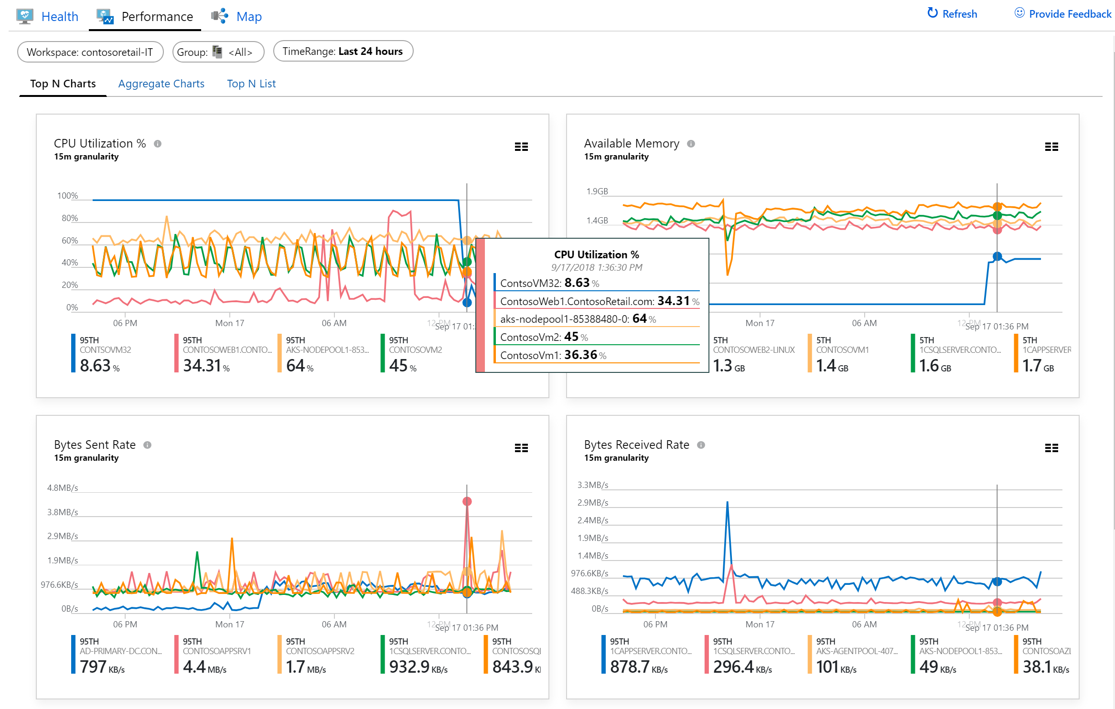
Rich Insights for Virtual Machines
NEW
Monitor single VMs or at scale
Identify & isolate host-level or guest-level health problems
Troubleshoot perf issues like CPU, memory, disk, and network
Visualize service dependencies & connection failures in Maps
Onboard at scale using PowerShell or Azure Policy
Learn more: BRK3354 (Monitor your infrastructure and analyze operational logs at scale with Azure Monitor)

Slide 14
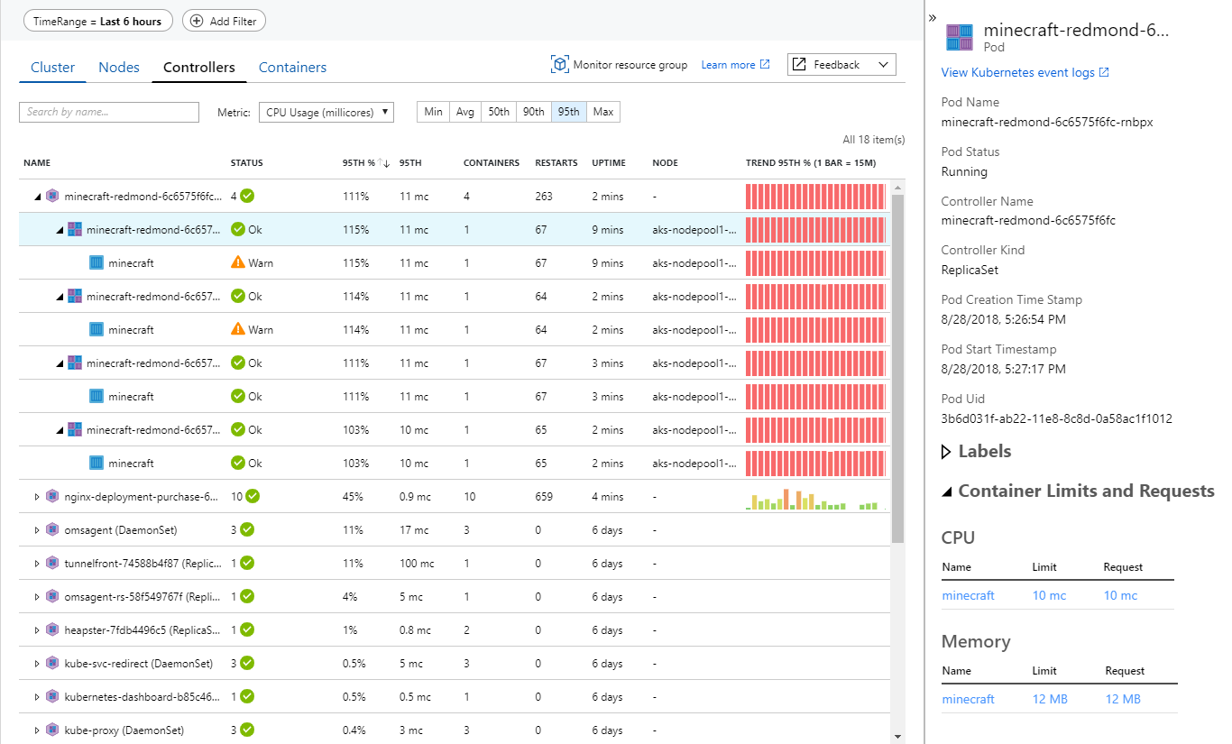
Drill down into AKS Containers
Monitor multi-cluster health & node/pod status NEW!
View overall perf across nodes, controllers and containers
Analyze Kubernetes event & container logs for troubleshooting
Understand cluster capacity needs under average or heaviest loads
Monitor containers on demand in AKS with virtual nodes NEW!
Learn more: BRK3354 (Monitor your infrastructure and analyze operational logs at scale with Azure Monitor)

Slide 15

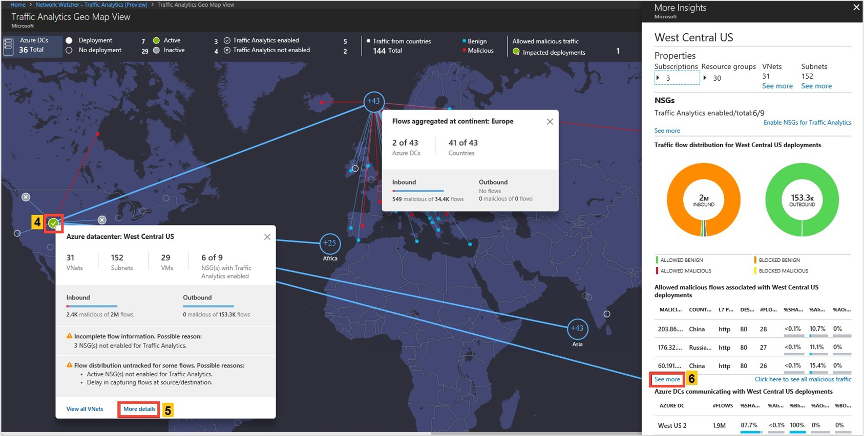
Monitor Network Health & Traffic
Secure and audit your network with Network Watcher Traffic Analytics
Discover and monitor ExpressRoute circuits, across subscriptions
Monitor ExpressRoute connectivity to virtual networks and O365
Monitor connectivity to LoB apps with Service Connectivity Monitor
Learn more: BRK3298 (Monitoring your networks in Azure)

Slide 16
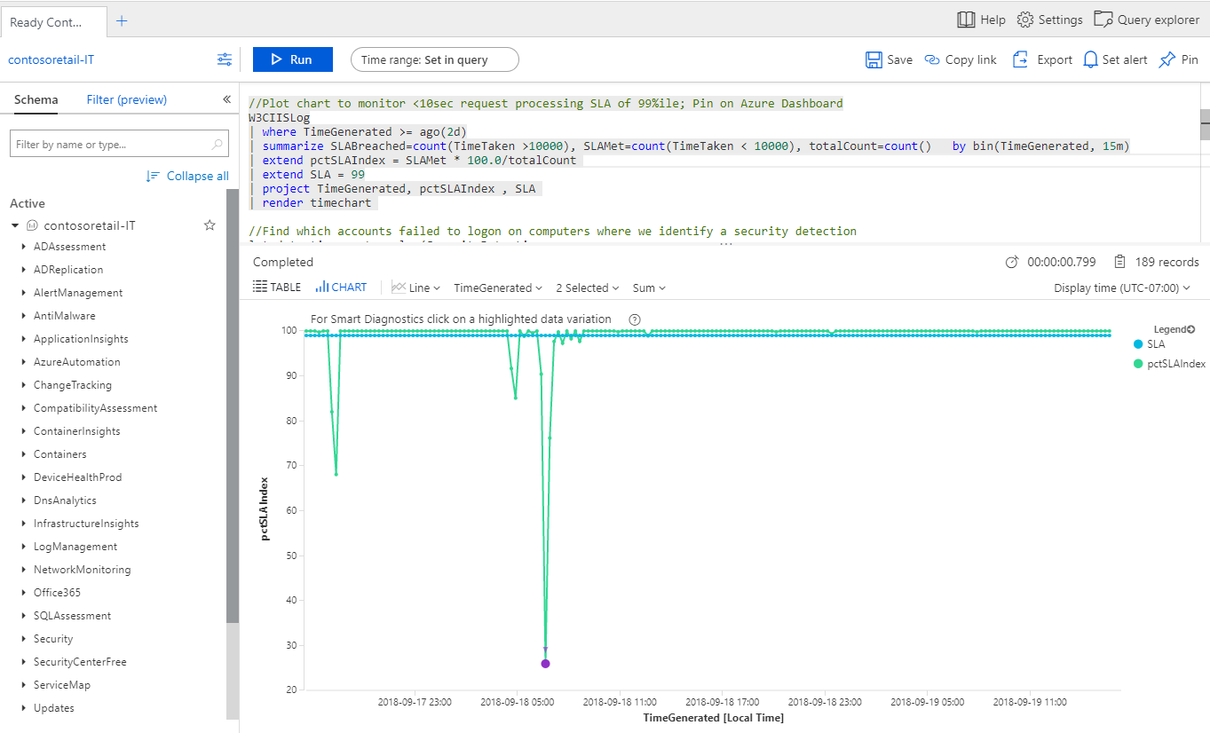
Advanced Queries with Log Analytics
Log Analytics advanced query experience now in Azure Portal
Central Analytics Platform across Monitoring, Management, Security
Run queries for investigations, statistics & root cause/trend analyses
Utilize ML algorithms for clustering and anomaly detection
Learn more: BRK3354 (Monitor your infrastructure and analyze operational logs at scale with Azure Monitor)

Slide 17
Demo
Azure Monitor

Slide 18
Recap: What’s New
Unified Monitoring
Data Driven Insights
Scale &Security
One Metrics. One Logs. One Alerts.
Log Analytics query experience integrated into Azure Portal
Integration into native Azure resource blades
Configure Azure AD to send audit & sign-up logs to Azure Monitor
Ability to send Custom Metrics
Azure Monitor for resource groups
Azure Monitor for VMs (health, performance, and maps)
Multi-cluster health rollup view for AKS
Distributed Tracing for Python/Go in addition to .NET, Java & Node.js apps
Java Local Forwarder, Micrometer & Spring Boot support
Onboard VMs at scale via Azure Policy
Secured monitoring inside Virtual Networks
Store logs in firewall restricted secured storage accounts
Monitor ER and store NSG flow logs across subscriptions

Slide 19
Workflow Integrations

Slide 20
Unified Monitoring
Azure Monitor
Insights
Application
Container
VM
Monitoring Solutions
Application
Operating System
Visualize
Metrics
Dashboards
Views
Power BI
Workbooks
Azure Resources
Azure Subscription
Analyze
Logs
Metrics Explorer
Log Analytics
Azure Tenant
Respond
Custom Sources
Alerts
Autoscale
Integrate
Event Hubs
Logic Apps
Ingest & Export APIs

Slide 21
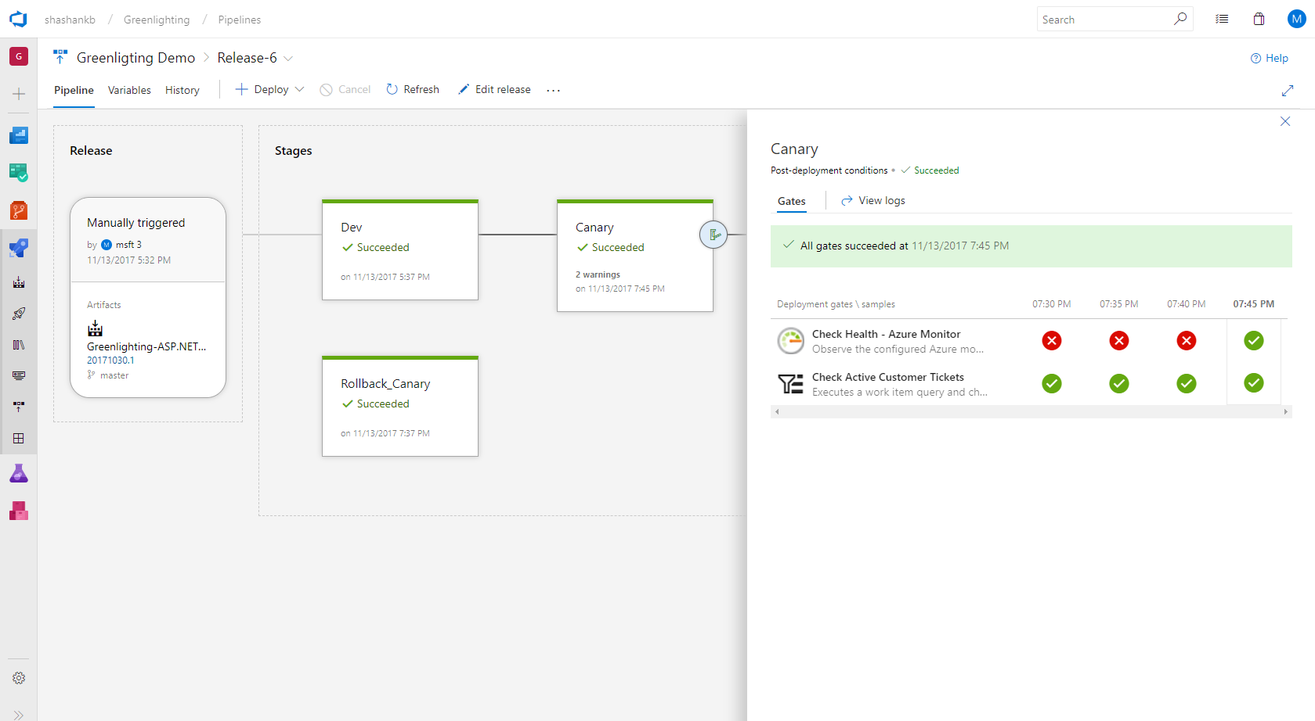
Continuous Monitoring for DevOps & IT Ops
Native IDE integrations in VS (.NET) and VS Code (Node.js)
Onboard with Azure Pipelines Release Management & DevOps Projects
Configure Pre- or Post-Deployment Quality Gates in Azure Pipelines
Run Load Test or Multi-Step Web Test for Synthetic Perf Monitoring
Work Item Management with Azure Boards for filing bugs and tracking
Alerts & Notifications with automated actions & ITSM integrations
Learn more: BRK3346 (Build the right solution for your business by Continuous DevOps Monitoring and Learning)

Slide 22
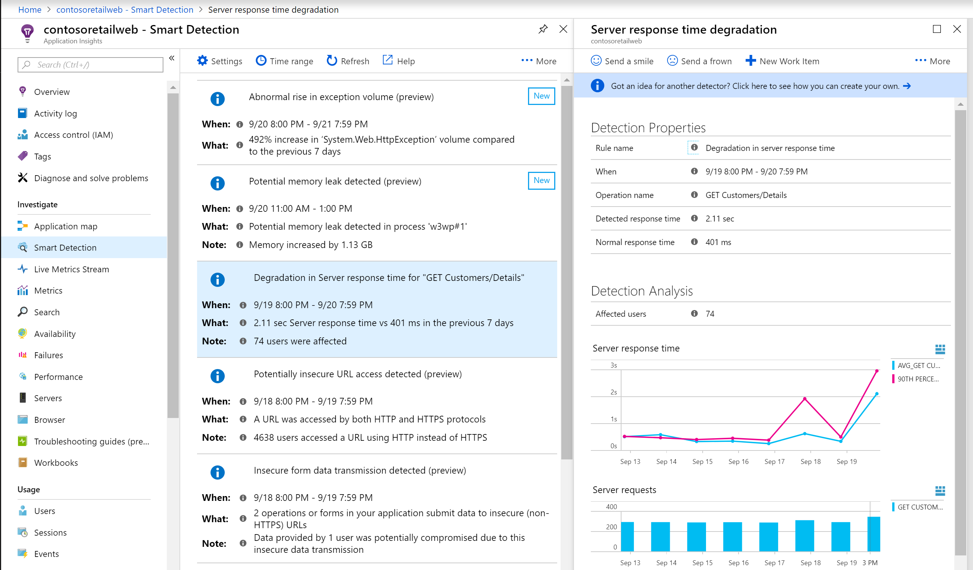

Azure Monitor & AIOps
Proprietary AI based Smart Detection for discovering anomalies
Smart Alert Management with Dynamic Thresholds for automatic baselining
Partnering with NMLStream to integrate additional ML capabilities for more powerful AIOps
Working with ML community internal/external to bring deeper intelligence for DevOps/SRE teams
Learn more: Expo Theater Session (Smart Alert Management with Machine Learning from Azure Monitor)

Slide 23
Partner Integration

Slide 24
Integration themes
Export data to existing cloud management tools
Ingest custom data to Azure Monitor
Security & Incident management
OSS Integrations
Dashboarding/Reporting
Monitor Proprietary Workloads
Analytics tools, Cost Management

Slide 25











Integrate metric data into a partner system
Azure Monitor
Application
Operating System
Metrics
Integrate
APIs
Azure Resources
Custom Sources

Slide 26
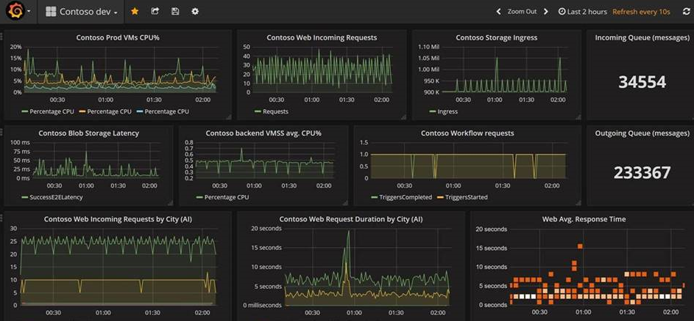
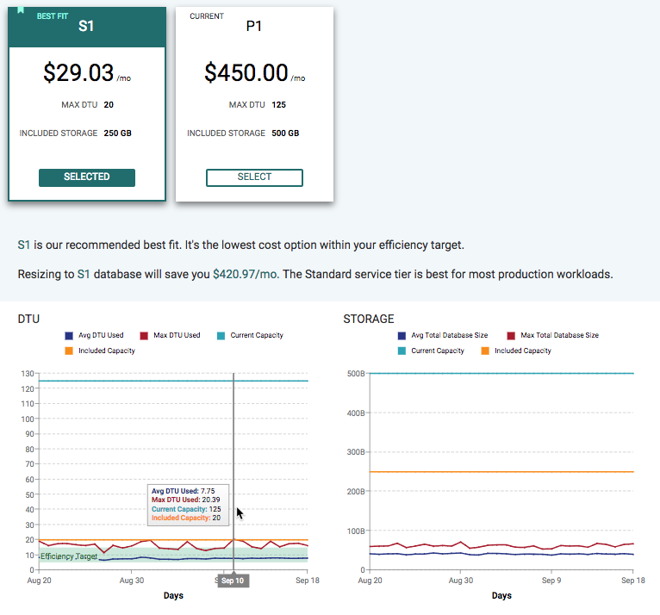

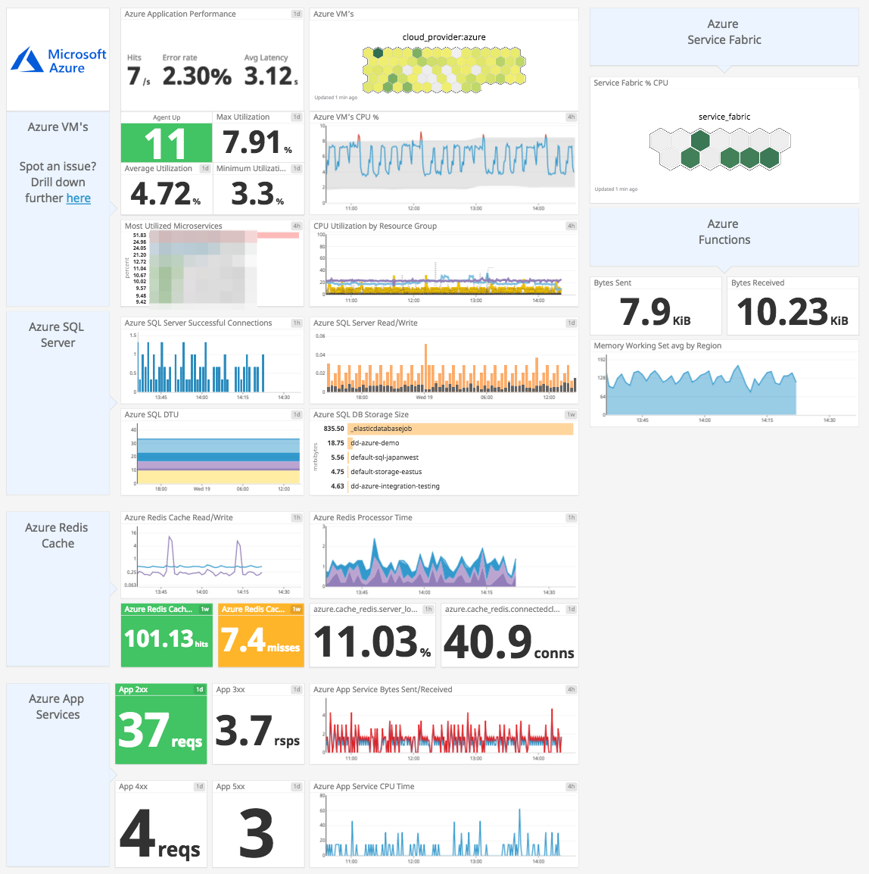

Metric data – use cases
Ops Center Dashboards & Reporting
Cost Management & Recommendations
Full Suite of Monitoring & Analytics

Slide 27





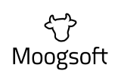


Integrate logs with a Log Analysis tool
Azure Monitor
Application
Operating System
Event Hubs
Azure Resources
Logs
Integrate
Azure Subscription
APIs
Azure Tenant
Logic Apps
Custom Sources

Slide 28
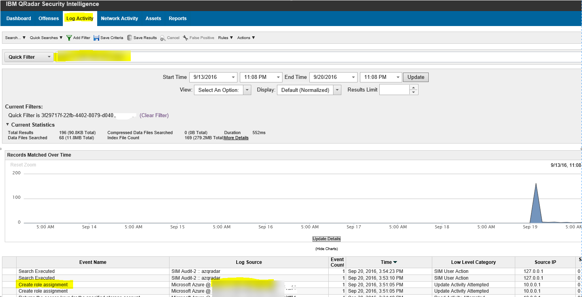
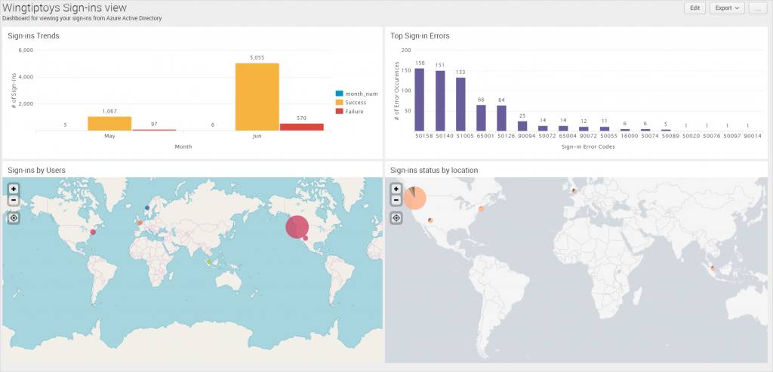
Log data – use cases
Security and Threat Detection
Enable Developer Investigations

Slide 29

Integrate your alerts into a partner system
Azure Monitor
Service Now
ITSM Integrations
Cherwell
Application
Provance
Webhooks
Operating System
Metrics
Automation Runbook
Azure Resources
Respond
Logic Apps
Azure Subscription
Alerts
Logs
Azure Tenant
Azure Functions
SMS/Email/ Voice/Mobile App
Custom Sources

Slide 30
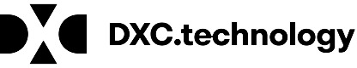



Partner Solutions for Apps & Workloads
ISVs / MSPs / SIs are extending and building solutions on top of Azure Monitor for specific scenarios & workloads
Some solutions help monitor diverse technologies deployed on Azure
Apache, Citrix NetScaler, F5 SLB, SAP Hana, Oracle, etc.
Others use their proprietary technologies to provide deeper scenario specific insights or diagnostics workflows
Learn more: BRK3349 (Everything about Azure Monitor telemetry and building integration with ITSM/SIEM tools)

Slide 31
Integration themes
Export data to existing cloud management tools
Ingest custom data to Azure Monitor
SIEM, ITSM, APM
OSS Integrations
Dashboarding/Reporting
Monitor Proprietary Workloads
Analytics tools, Cost Management

Slide 32
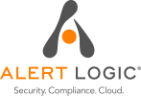






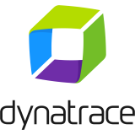
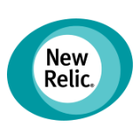
Key Takeaways
Azure Monitor is best for Azure, and provides both APM & SIEM capabilities
Open and extensible to continue using your favorite tools & solutions
Integrate your existing APM/Monitoring solutions with Azure Monitor
Route telemetry to your SIEM solutions for analytics & security management
Extend & build on top of Azure Monitor for specific scenarios & workloads

Slide 33
Roadmap
Rich insights for Azure Storage, SQL & Service Fabric Mesh
RBAC per data type in Log Analytics
Support for containers on demand for AKS with virtual nodes
Support live logs for containers and Kubernetes events
Smart detections and alerts with Dynamic Thresholds
Expanded Azure support and interoperability for Distributed Tracing
Exception tracking and custom metrics for Python and Go apps
Auto enablement of app monitoring for App Services / Windows VMs (with WAD)
Expanded region availability across public & sovereign clouds
Latency improvements for Alerts, Logs & Metrics

Slide 34
Data Platform

